Slide 1

IDENTIFYING FAKE JOB POSTINGS
By:
Charles Albert
Hilda Flores
Caroline Kurzweg

Slide 2
TABLE OF CONTENTS
01
02
03
PROJECT OVERVIEW
DATASET
MODELLING
04
05
INSIGHTS
QUESTIONS
Brief, success of the project and assumptions.
Obtaining, wrangling and creation of training and test dataset.
Selection of best model.
Prediction score and confusion matrix.
Interesting findings and lessons learned.
Section of questions and answers.

Slide 3

01
PROJECT OVERVIEW

Slide 4

FAKE JOB POSTINGS
When people are looking through different sites to find the most interesting job postings according to their professional objectives, they may encounter various job postings and send personal information such as resumé, contact information and even social security number to further proceedings regarding job interviews.
Nonetheless, though rare, there is a risk that the job posting might be fake. Consequently, personal information is at stake.
Therefore, this project aims to identify fake job postings in order to reduce the risk of being the victim of fraud and potentially identity theft .

Slide 5
How Will We Determine Success?
95% of data is as not fraudulent.
Accuracy > 95% will be considered a success.
Small amount of success is still important because personal information is at stake.
We would rather false positives due to the serious nature of the problem.

Slide 6
ASSUMPTIONS
Data set is representative of the whole population
Variables measured at a nominal level
Variables consist of two or more categorical independent groups

Slide 7

02
DATASET

Slide 8
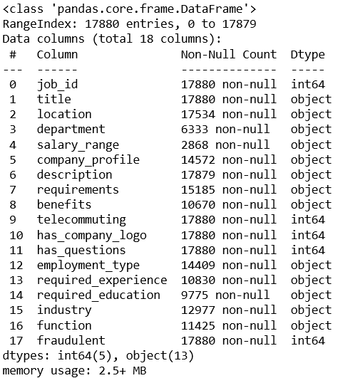
Overview
FAKE JOB DATA
From The University of the Aegean
17880 Observations
18 Variables
Dependent Variable: ‘fraudulent’
Only 1 Missing Value for Description(IV)
Other Variables Missing Lots of Data

Slide 9
GOOD DATASET?
For our purposes, this data set is good. Since our Independent Variable, ‘Description’ , is only missing 1 value and our dependent variable, ‘Fraudulent’, is missing no values, we are considering this a good, clean data set.

Slide 10

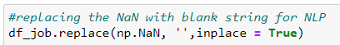


DATA WRANGLING
Not much Data Wrangling needed
Replaced NaN with ‘’
Only 1 missing Description
Drop excess columns

Slide 11
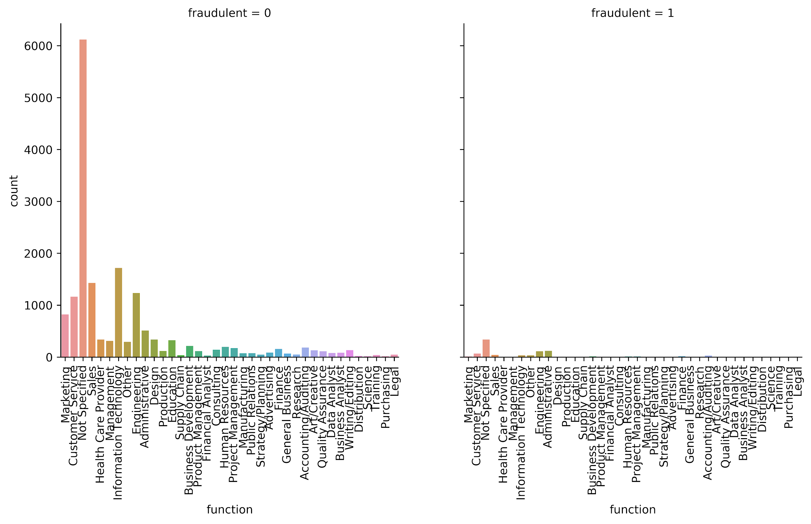
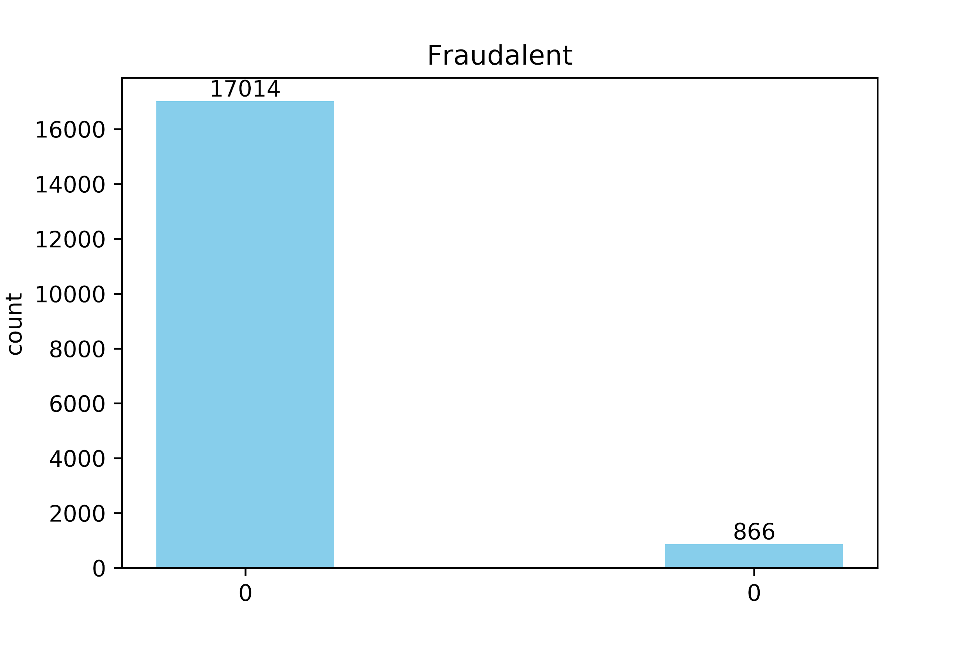
VISUALS

Slide 12



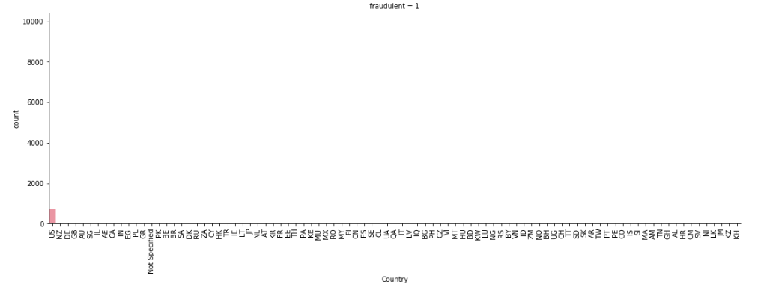
USA 1° in fraudulent job postings
84.3%
4.6%
2.7%

Slide 13
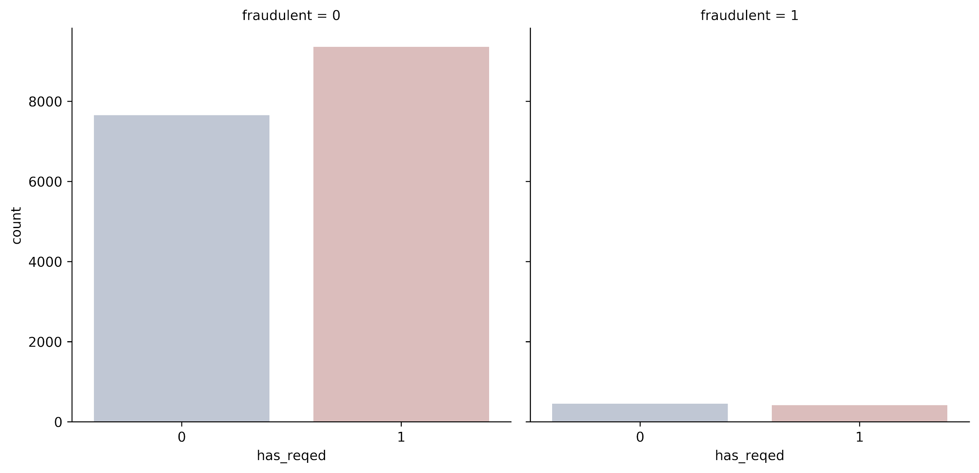

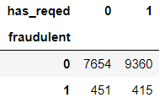
VISUALS
For future investigations…
More sampling of fake job postings could determine if not posting required education is key to classify.

Slide 14

03
MODELING

Slide 15
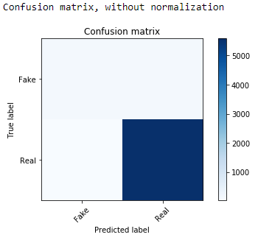
NATURAL LEARNING PROCESS
PREDICTION SCORE
136
150
33
5582
***Random state = 25
.9690

Slide 16
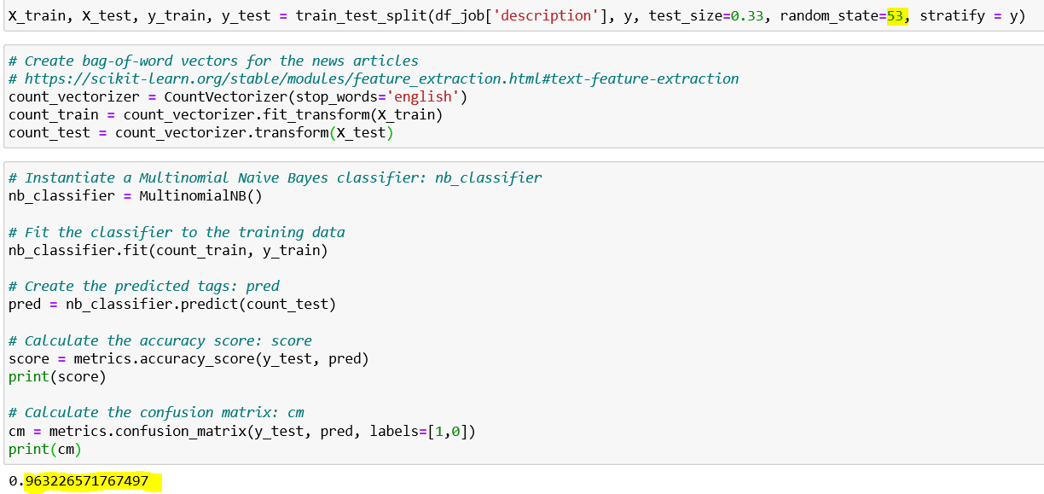
Example Code

Slide 17
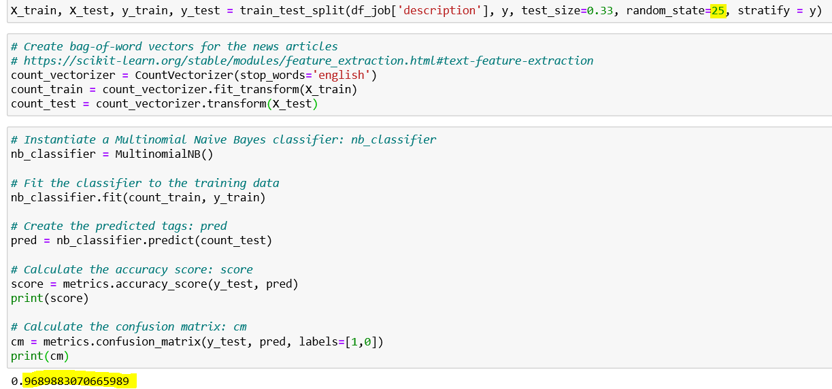
Example Code

Slide 18

04
INSIGHTS

Slide 19
Insights From Model
Using NLP model we can better predict job listing fraud.
Description as the best variable for classifying
95% -> 96.9% accuracy
Success!
This model can be used to classify jobs as fake/real

Slide 20

Other Models Tried
NLP using Company Profile
NLP using Requirements
NLP using benefits
Random Forest using dummy coded variables
Decision Tree using dummy coded variables
Logistic Regression

Slide 21
Personal Insights
Caroline
Get creative! There are so many ways to get interesting insights. Do the research and learn new ways to create models. Even if the models are not successful, thinking outside the box will help me learn more.
Carter
I thought that is was very interesting that the benefits column was such a high performer. If done again, I would like to try to incorporate salary range to see if fraudulent job postings are advertising a certain structure to their salary and benefits package as an incentive to get people to apply.
Hilda
I was very surprised that industrialized countries had the more fake job postings than the most corrupt countries in the world! Personally, I think it is due to lack of sampling on those countries. So, I would get more sampling on fake job postings to corroborate this insight. Also, I would include in which sites are the fake job postings are advertised and accounts of enterprises that contact you through different platforms. This would help visualize which platforms need more security and help identify which sites are preferred to advertise fake job postings.

Slide 22

THANKS
Does anyone have any questions?

